Slide 1

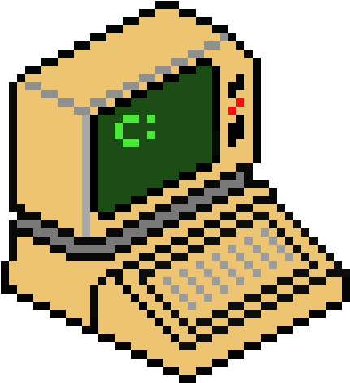
PYTHON SEQUENCES
*DICTIONARIES*
-Siddarth & Navaneeth

Slide 2
*INDEX*
INTRODUCTION-DICTIONARIES | Basic Syntax, Dict{} constructor, Mutability, Other Characteristics
FUNCTIONS AND OPERATIONS | Different functions and operations of dictionaries
LOOPING TECHNIQUES | Presenting dictionaries visually better using for loops
EXAMPLES/RIDDLES | Many interesting puzzles/riddles/questions to strengthen your base on dictionaries
CONCLUSION | The intent of this presentation

Slide 3


1.INTRODUCTION-DICTIONARIES
GOOGLE:

Slide 4
1.1. BASIC SYNTAX
Name of dictionary
key:value pair
Separator ‘,’
Assignment operator
Parentheses ‘{}’

Slide 5
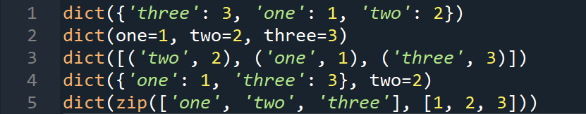
1.2. dict() CONSTRUCTOR
“The dict() constructor builds dictionaries directly from sequences of key-value pairs”
dict() is unique to dictionaries only

Slide 6
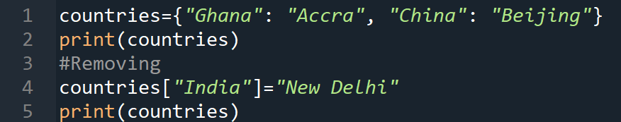
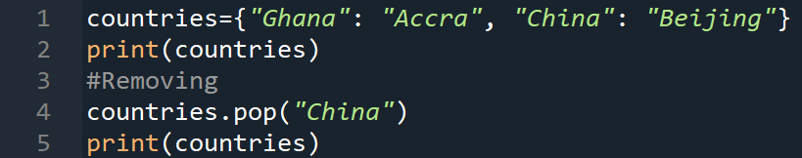
1.3. MUTABILITY- tendency to change
DICTIONARIES are MUTABLE.
1.ADDITION of KEY :VALUE PAIRS
2. REMOVING of KEY :VALUE PAIRS

Slide 7
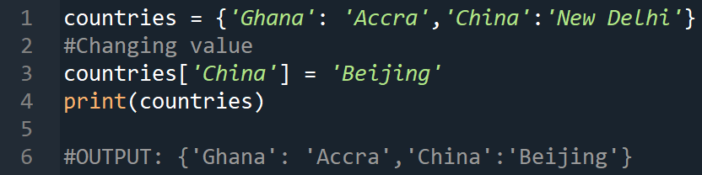
3. CHANGING KEY :VALUE PAIRS:
NOTE: KEYS ARE IMMUTABLE WHILE VALUES ARE MUTABLE

Slide 8
1.4. OTHER CHARACTERISTICS
Duplicates are not allowed
In Python 3.6 and earlier, dictionaries are unordered.As of Python version 3.7, dictionaries are ordered.
A key can be a tuple unless and until the tuple has no mutable elements in it

Slide 9

2.FUNCTIONS AND OPERATIONS

Slide 10
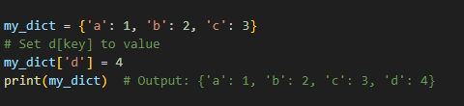
2.1. d[key]= value
EXAMPLE:

Slide 11
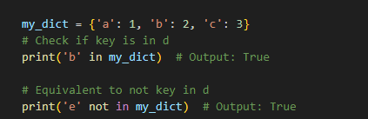
2.2. MEMBERSHIP OPERATORS
key in d:
key not in d:

Slide 12
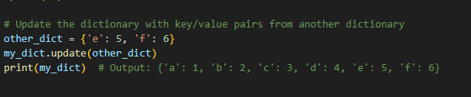
2.3. update(d)
EXAMPLE:

Slide 13
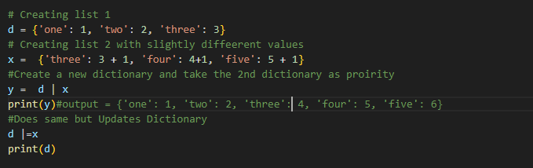
2.4. <d1>|<d2> and <d1>|=<d2>
EXAMPLE:

Slide 14
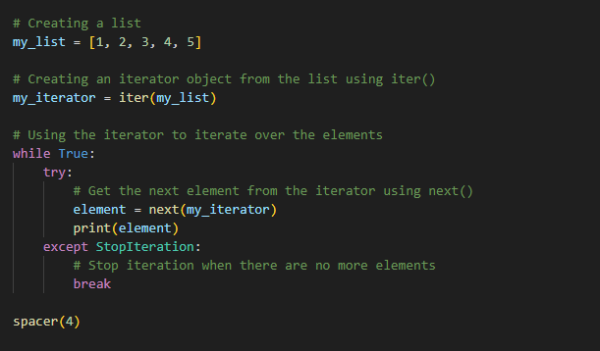
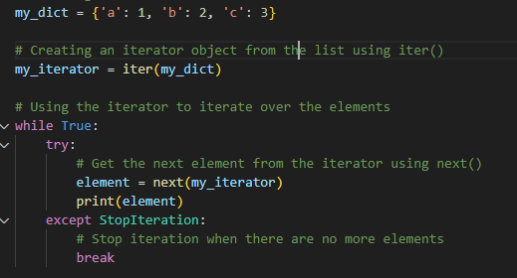
2.5. iter(d)
EXAMPLE:

Slide 15
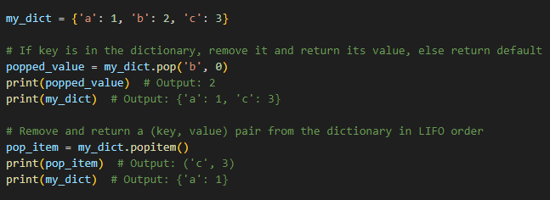
2.6. pop() and popitem()
EXAMPLE:

Slide 16
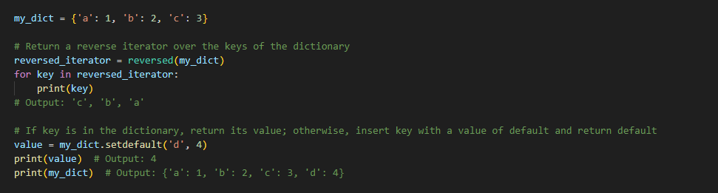
2.7. reversed(d)
EXAMPLE:

Slide 17

2.8. setdefault(key,[default])
EXAMPLE:

Slide 18
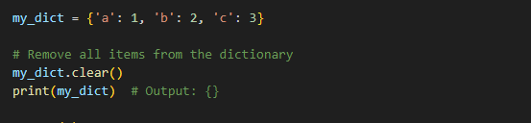
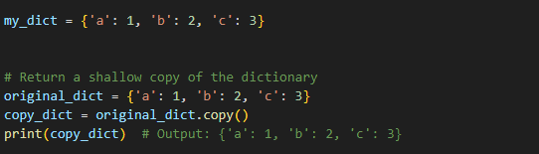
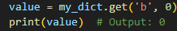
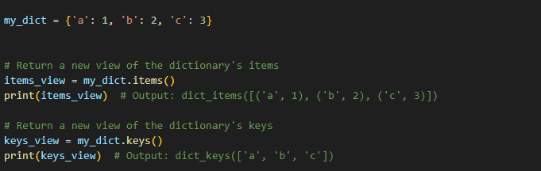
2.9. Other Functions
Example Dictionary
NAME
EXAMPLES
list()
len()
del d[key]
clear()
copy()
get(key,[default])
items()
keys()

Slide 19

3.LOOPING TECHNIQUES

Slide 20
3.1. Printing dictionaries
Using for loops
Basic way of presenting dictionaries:

Slide 21
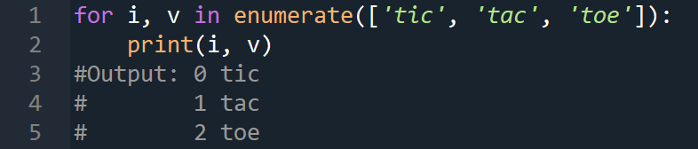
3.2. Using for loop without dictionaries
Using enumerate() function:

Slide 22
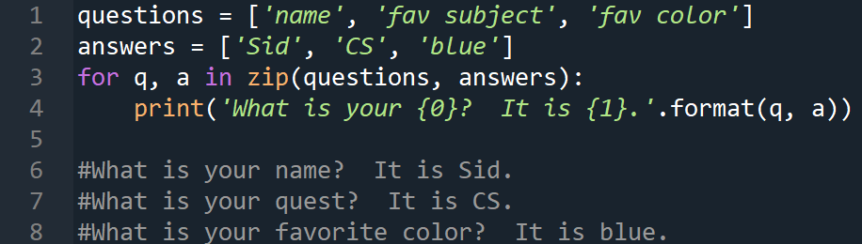
Using zip() function:

Slide 23
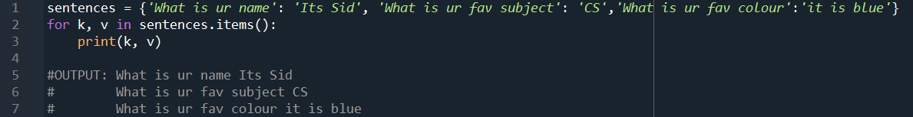
3.3. Using for loop with dictionaries
Using items() function:

Slide 24

4.EXAMPLES/RIDDLES

Slide 25
4.1. WAP to create a dictionary using user’s input

Slide 26
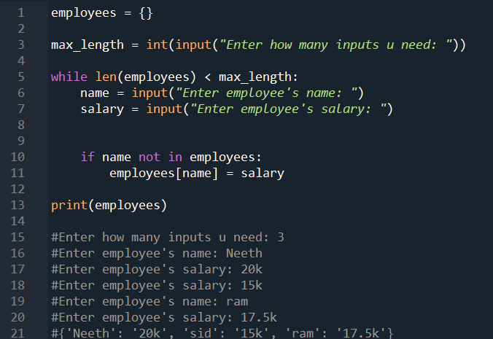
4.1. WAP to create a dictionary using user’s input

Slide 27
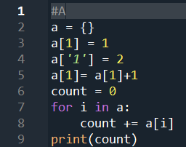
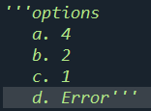
4.2. Some output based questions:

Slide 28
4.2. Some output based questions:

Slide 29
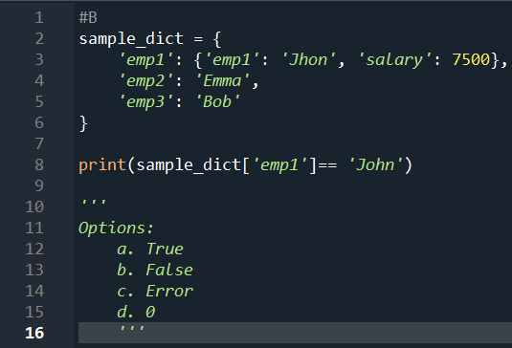

Slide 31
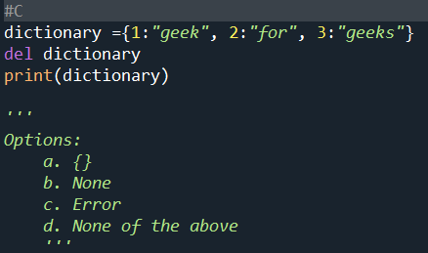

Slide 33

4.3. Is the following statement valid?

Slide 34
4.3. Is the following statement valid?
NO!! But is it possible to achieve this?

Slide 35
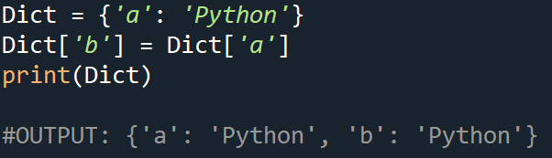
YESS!!

Slide 36

5.SUMMARY AND CONCLUSION

Slide 37

5.1. What did we learn?
* Basics of dictionaries
* Varied number of functions
* Presenting dictionaries
* Solving interesting examples and riddles
* CREATING A FOUNDATION FOR FUTURE IMPLEMENTATION

Slide 38
THANK YOU
-Navaneeth & Siddarth

